Slide 1
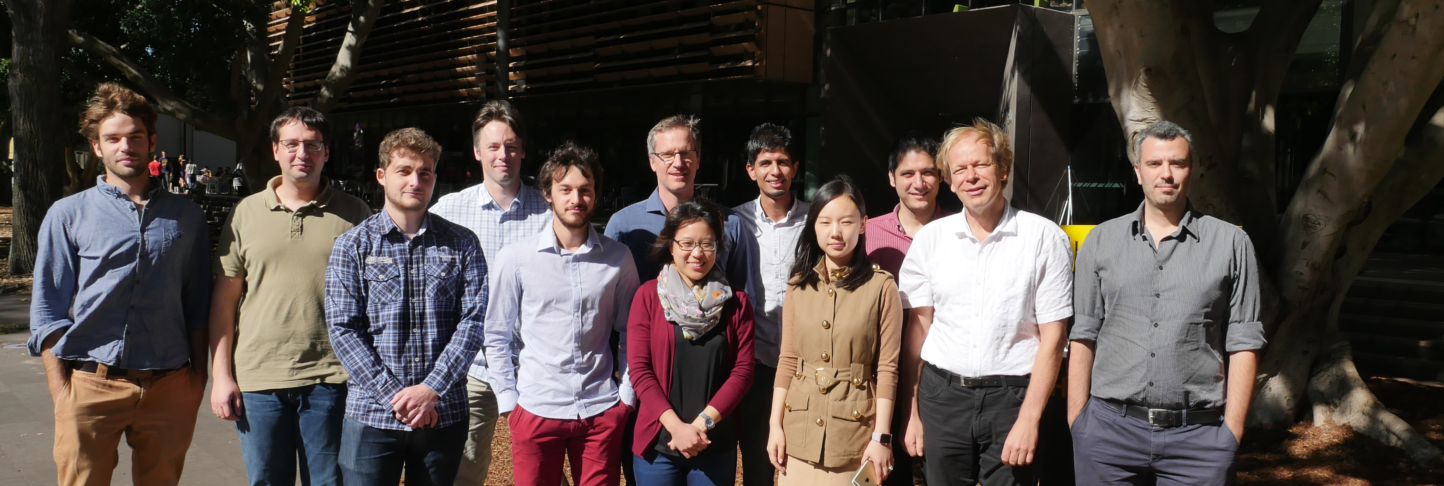
Analysis of Dynamics in Multiphysics Modelling of Chemically Active Creeping Faults
Sotiris Alevizos, Thomas Poulet, Manolis Veveakis and Klaus Regenauer-Lieb
UNSW Petroleum Engineering
CSIRO Energy and Mineral Resources
School of Petroleum Engineering
Unconventional Geomechanics Group (UGG)
http://ugg.unsw.edu.au

Slide 2
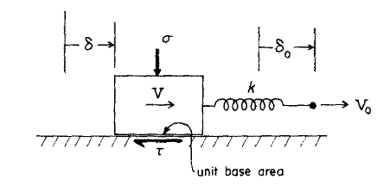
Modelling concept
Rice (2006) JGR, Vol. 111, B05311
Thermal pressurization
Flash heating of the contacts
Microscopic melting
Gel formation
Sulem & Famin (2009) JGR, Vol. 114, B03309
Chemical decomposition of the solid skeleton
Gu et al. 1984

Slide 3
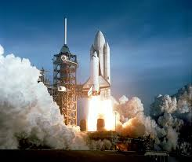
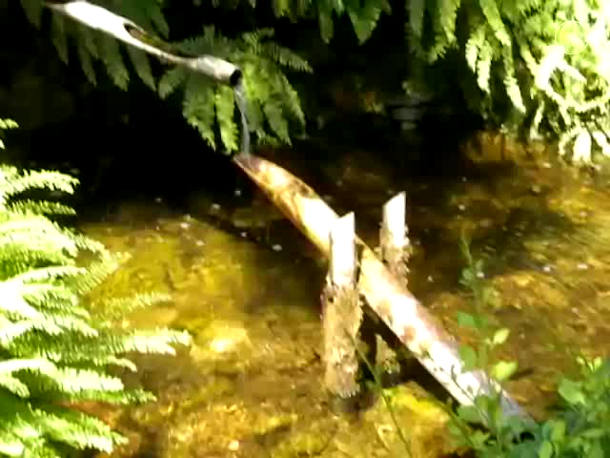
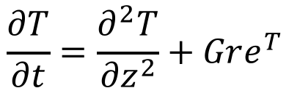
Chemical oscillator
Shear Heating Feedback + Chemical Reactions
$$\frac{∂T}{∂t}=\frac{∂^{2}T}{{∂z}^{2}}+Gre^{T}$$

Slide 4
Shear heating as an energy source

Slide 5
Spatial observations – Glarus Thrust
Poulet et al. 2014, GRL

Slide 6
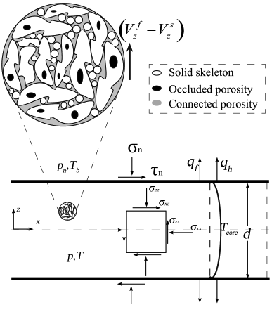
Chemical model and balance laws
  Fluid-saturated rock
  Mechanical (Shear) heating
  Darcy law for the fluid flow, Fourier law for heat conduction and Arrhenius law for the mass production rate
Alevizos et al. 2014, JGR

Slide 7
Macroscopic considerations – Rate and state friction
Gu et al. 1984
It can be shown (Rice, 2001) that such a rheology originates from a
creeping flow law of the type,
at the isothermal limit. Similar, results can be obtained by adopting a viscoplastic
(Perzyna type) of model corresponding to power law creep (Veveakis et al. 2010, 2014),

Slide 8
Viscoplastic constitutive model
x
q
deviatoric
x
volumetric
p’
Poulet & Veveakis 2016, Comp. and Geot. and Poulet et al. 2016, RMRE

Slide 9
Far field, constant stress boundary conditions
Alevizos et al. 2016, PEPI (in press)

Slide 10
Normalized system of equations at the critical state limit
Normalized balance laws
z
Main dimensionless groups
Alevizos et al. 2016, Mathematics

Slide 11
System’s stability regimes w.r.t Gr
Stable creep
Non periodic behaviour
Periodic
behaviour
Safe operating domain
Core temperature
Gruntfest number
Gruntfest Number = Mechanical Dissipation/ Heat Conduction
Notes:
VSTH

Slide 12
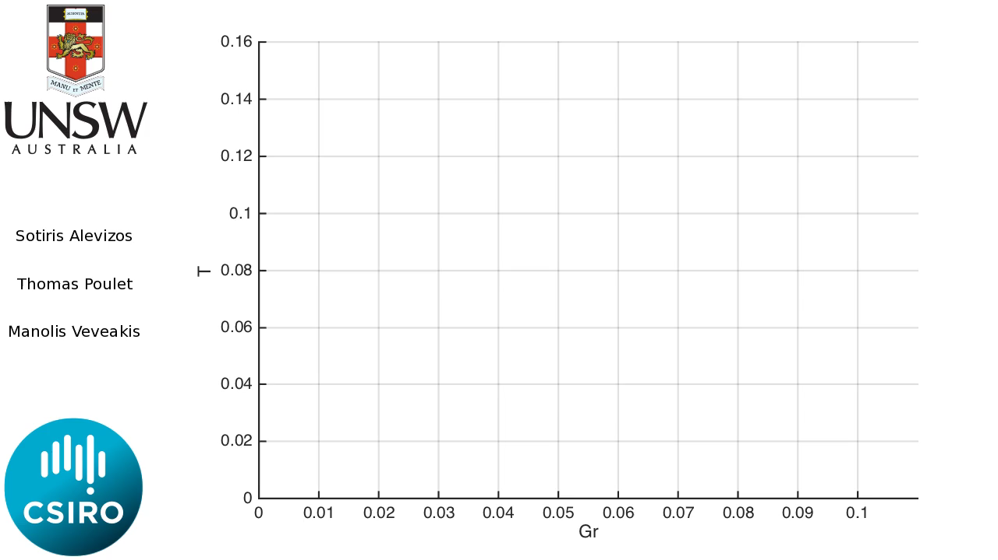
Numerical continuation results

Slide 13
Numerical continuation results – Non-linear dynamics
Homoclinic point
Hopf point
The Lewis number is controlling the dynamics of the system, leading to non-linear effects such as limit cycles (stable oscillations)

Slide 14
Numerical continuation results – Non-linear dynamics
Homoclinic bifurcation
Transitional/bistable area
No oscillations
The bifurcation points in the space

Slide 15
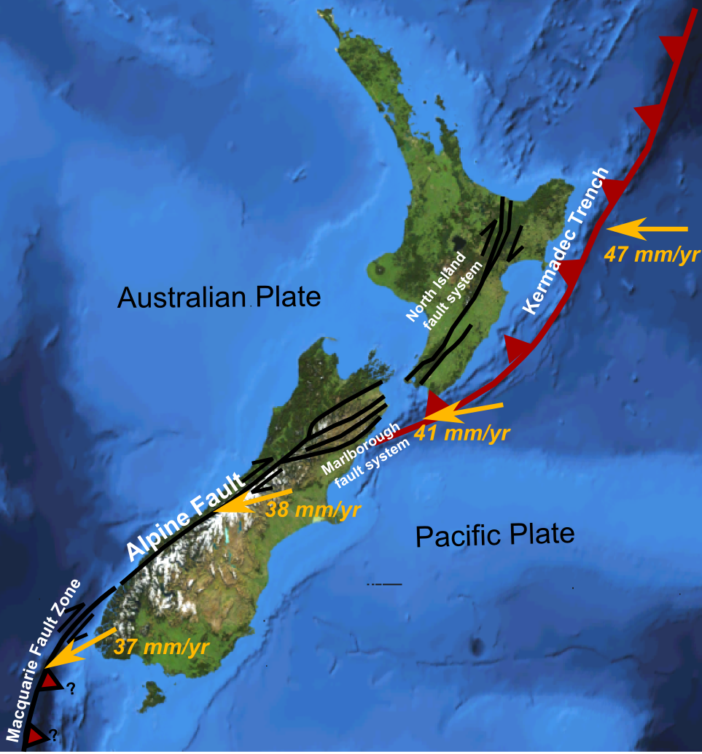
Application to subduction zones
Location of the plate boundary
Wikipedia
Poulet et al. 2014, JGR

Slide 16
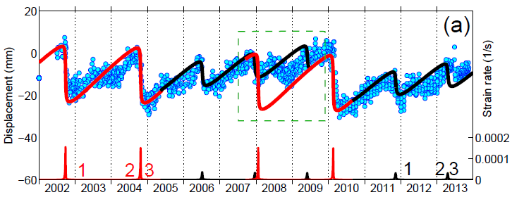
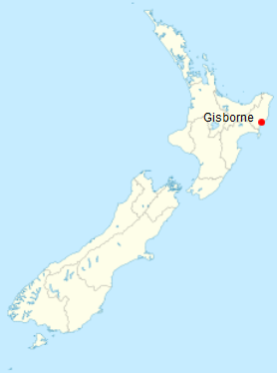
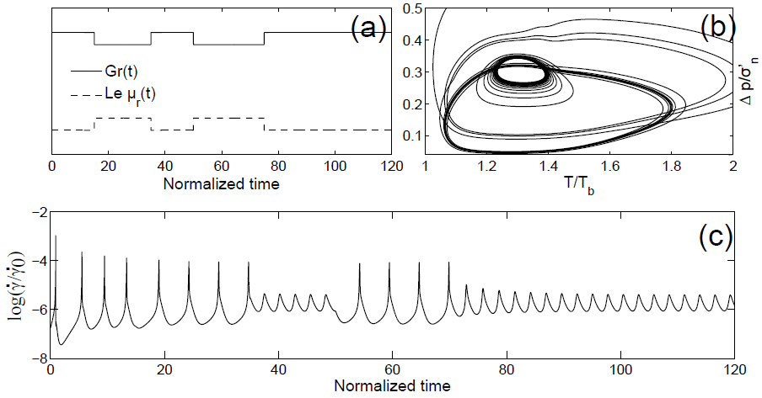
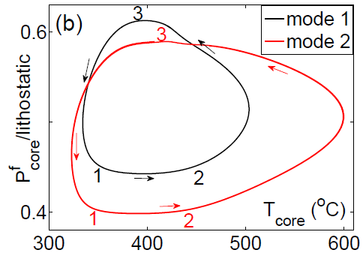
Application to ETS sequences – Gisborne (New Zealand)
$$5{Mg}_{3}{Si}_{2}O_{5}{\left(OH\right)}_{4}↔{Mg}_{3}{Si}_{4}O_{10}{\left(OH\right)}_{2}+6{Mg}_{2}SiO_{4}+9H_{2}O$$

Slide 17
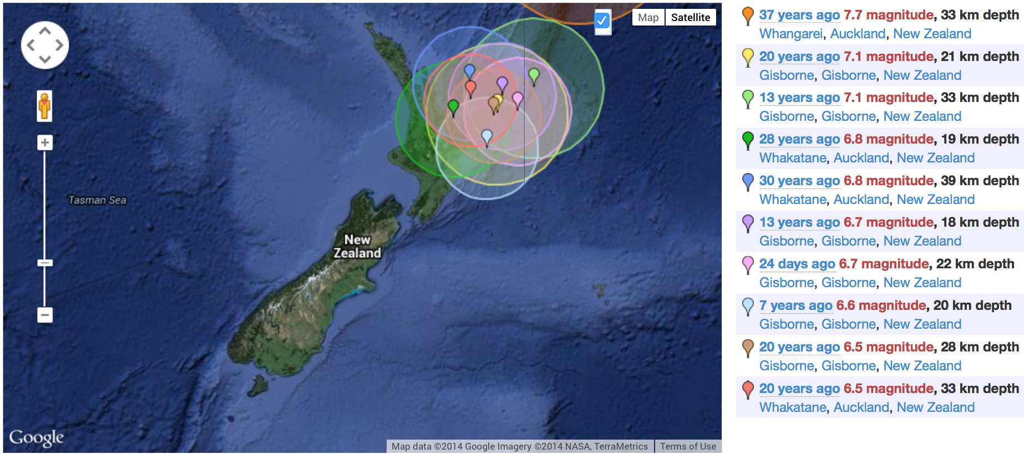
Seismic observations
Biggest brittle earthquakes around Gisborne
http://earthquaketrack.com

Slide 18
References
  Alevizos, S., T. Poulet, and E. Veveakis (2014), Thermo-poro-mechanics of chemically active creeping faults. 1: Theory and steady state considerations, J. Geophys. Res. Solid Earth, 119, doi:10.1002/2013JB010070.
  Veveakis, E., T. Poulet, and S. Alevizos (2014), Thermo-poro-mechanics of chemically active creeping faults: 2. Transient considerations, J. Geophys. Res. Solid Earth, 119, doi:10.1002/2013JB010071.
  Poulet, T., M. Veveakis, K. Regenauer-Lieb, and D. A. Yuen (2014), Thermo-poro-mechanics of chemically active creeping faults: 3. The role of serpentinite in episodic tremor and slip sequences, and transition to chaos, J. Geophys. Res. Solid Earth, 119, doi:10.1002/2014JB011004.
  Poulet, T., M. Veveakis, M. Herwegh, T. Buckingham, and K. Regenauer-Lieb (2014), Modeling episodic fluid-release events in the ductile carbonates of the Glarus thrust, Geophys. Res. Lett., 41, 7121–7128, doi:10.1002/2014GL061715.
  Alevizos, S., Poulet, T., Veveakis, M. and Regenauer-Lieb, K. (2016). Analysis of Dynamics in Multiphysics Modelling of Active Faults. Mathematics, 4(4), 57; doi:10.3390/math4040057
  Poulet, T., Paesold, M., Veveakis, M., 2016. Multi-physics modelling of fault mechanics using redback: A parallel open-source simulator for tightly coupled problems. Rock Mechanics and Rock Engineering, 1-17. URL http://dx.doi.org/10.1007/s00603-016-0927-y
  Poulet, T., Veveakis, M., 2016. A viscoplastic approach for pore collapse in saturated soft rocks using redback: an open-source parallel simulator for rock mechanics with dissipative feedbacks. Computers and Geotechnics 74, 211-221.
  Alevizos, S., Poulet, T. and Veveakis, E. (2016). Episodic tremor and slip (ETS) as a chaotic multiphysics spring. Phys. Earth Plan. Int., in press.

Slide 19




GEOPROC 2017
July 5-7, 2017 Paris, France
The 6th International Conference on Coupled Thermo-Hydro-Mechanical-Chemical (THMC) Processes in Geosystems: Multiphysical instabilities across the scales
Important dates
Abstract submission: 30 October 2016
Abstract acceptance: 15 November 2016
Early-bird registration: 31 January 2017
Contact
geoproc2017-contact@enpc.fr
Thank you!

